Slide 1








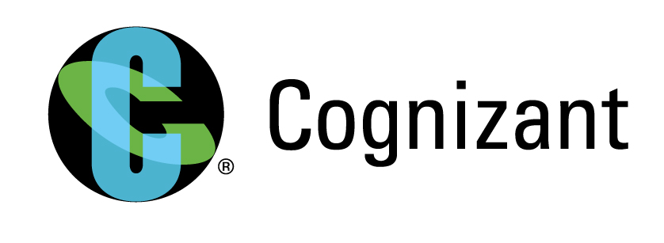
EDMS Lineage Using Collibra
Collibra’s Data Governance Center supports the process of data management through a web-based, collaborative Data Governance platform.
Key Highlights
Source
The data Used as source are the Lineage documents from the different SORs like UDS, UIS,TAM, BIOS,CBS,CDF
6 Source System
(UDS, UIS,TAM, BIOS,CBS,CDF)
2 Team members
Solution Highlights
The team first review the files (Linage along with RDZ, API) and prioritize the products/LOBs.
Initial Assessment is done and setup done for product identification.
Request for Metadata Artifacts for the Product to EDMS Team.
Metadata artifacts are verified by Metlife SME’s after receiving.
If verification gets passed then the verified data are onboarded in Collibra syatem and data which fails verification goes back to EDMS team for new data.
It is followed by generation of templates in excel format files that would be used to load the data details of the Lineage along with RDZ, API into Collibra Data Governance Center .
All the data are linked with one another so as to have an idea about the interdependency of various artifacts which can be view as traceability diagram in CDG.
Data for Lineage is extracted from the Lineage documents along with RDZ, API document and process in Collibra Data Governance
The Lineage documents of the different SOR along with RDZ, API is checked and then processed in CDG
3 month engagement
Technology Stack: Collibra Data Governance Center
Business Outcome
The data artifacts are linked with one another so the team can have an idea about the interdependency of various artifacts through traceability diagrams.
The application owners team have a overall picture of the data of their system

Slide 2

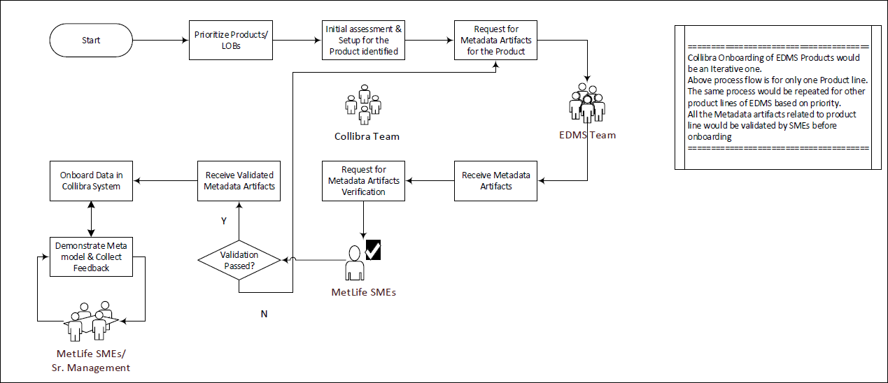



EDMS Lineage Using Collibra
Solution Details
Solution Architecture
Some mechanical task of uploading the data in CDG are automated by creating templates in excel format.
Value adds/
Investments
Initially all development was done manually that took a lot of effort.
Great time was invested to develop the templates.
Solution Description
Ingesting reference data code sets into Collibra from a variety of sources, including databases
Defining code patterns to govern reference data at the core
Building and managing structures over the code sets of reference data
Mapping of code values between code sets combining filters and diagrams
Versioning of code values, code sets, code mappings
Challenges Faced

